Slide 1

2020-01 CAU
Natural Language Processing and Information Retrieval
Text Indexing Project
Word distribution depending on the features of movies
20161856 Jihyo Han
Notes:
Hello I’m Jihyo Han,, and I’ll present of my text indexing project

Slide 2

Contents
Introduction – Hypothesis
Development – Environment, Code details
Conclusion – Results
Notes:
The contents is like that

Slide 3
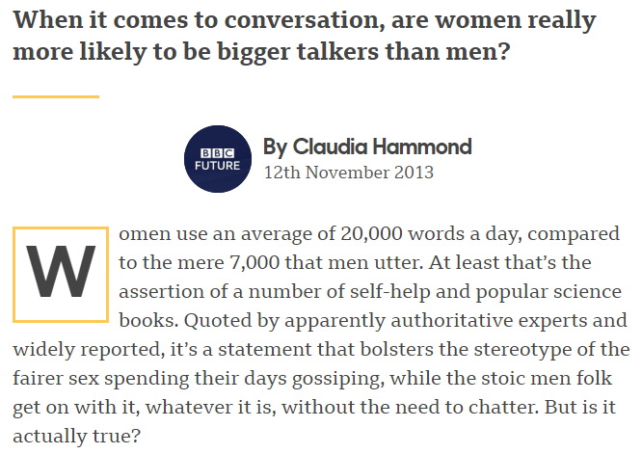
Introduction - Hypothesis
?
Does women
really talk a lot
than men do?
Assumptions
Female leading movies would have much more words in film than male leading movies do.
Vocabularies would be more diverse and feminine in female leading movies rather than male movies are.
https://www.bbc.com/future/article/20131112-do-women-talk-more-than-men
Notes:
In this project, I’ve got inspired by the common stereotype that “women talk a lot than men do”. Indeed there are several investigations, but I wanted to look at the movies especially.
What I assumed is, First, in female leading movies, the word frequency would be higher than in male leading movies. Secondly, the vocabularies in female leading movies would be more diverse and feminine kind, while words in male movies are bold and simple.
And of course, there would be definitely more, not only differences but also similarities between movies where females are mainly starring and the movies where male actors are leading.

Slide 4
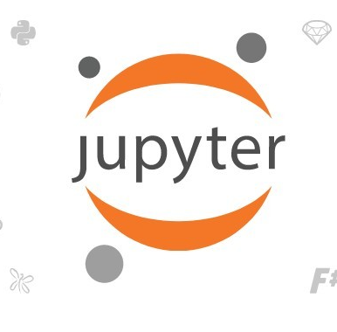
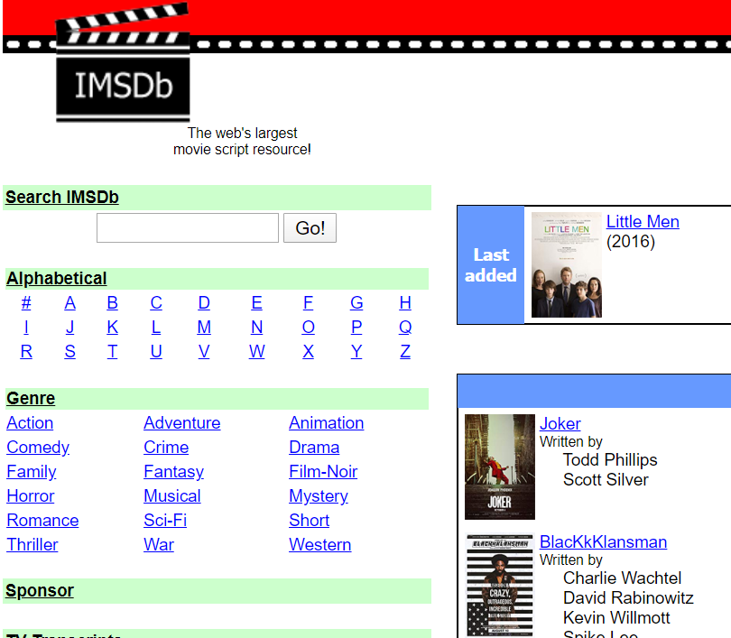
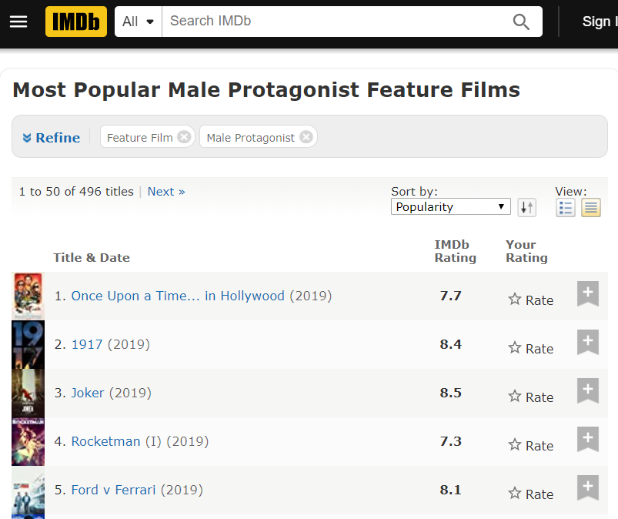
Development - Environment
Movie Scripts
From IMSDb
https://www.imsdb.com/
Select 50 Movies each based on IMDb investigation
Jupyter notebook
- Python 3.7.4
regardless of genres
Male: https://www.imdb.com/search/keyword/?keywords=male-protagonist&sort=moviemeter,asc&mode=simple&page=1&ref_=kw_nxt&title_type=movie
Female: https://www.imdb.com/search/keyword/?keywords=female-protagonist&mode=simple&page=1&ref_=kw_nxt&title_type=movie&sort=moviemeter,asc
Notes:
To develop, I use jupyter notebook with python version 3.7.4, and choose database, I mean movies based on IMDb investigation where the subject is “the most popular male/female protagonist feature films”. I could get 50 films’ scripts each, so total 100 films from IMSDb and compare them by counting and analyzing the words on that.

Slide 5

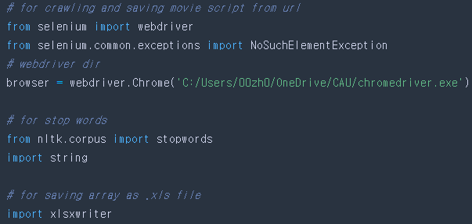
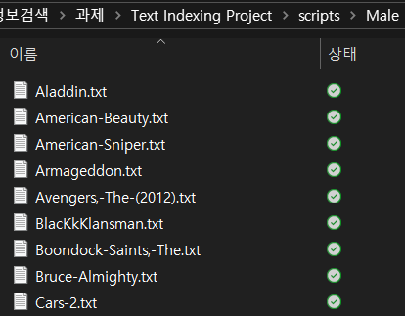
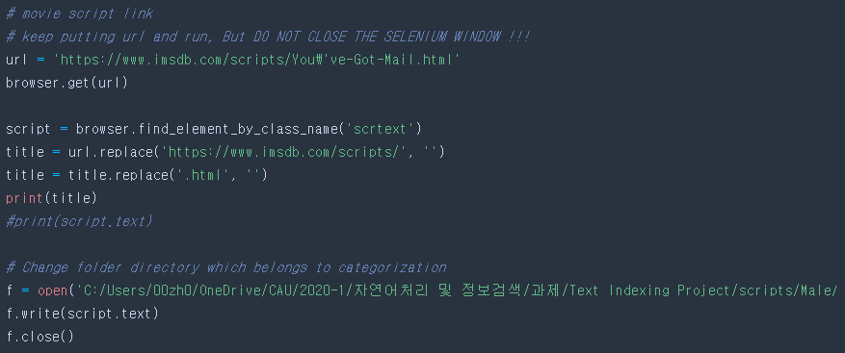
Crawl and Save movie script
Use chrome webdriver to crawl movie script text from input url and make .txt file automatically.
File name is from the site address which contains movie title.
Development – Code Details (scriptCrawl.ipynb)
Notes:
Before indexing and counting the words, I needed to get script files as txt file. So I coded the crawler using chrome webdriver, the selenium so I could get movie scripts text automatically when I put the webpage link. The file name is from the site address which contains movie title.

Slide 6
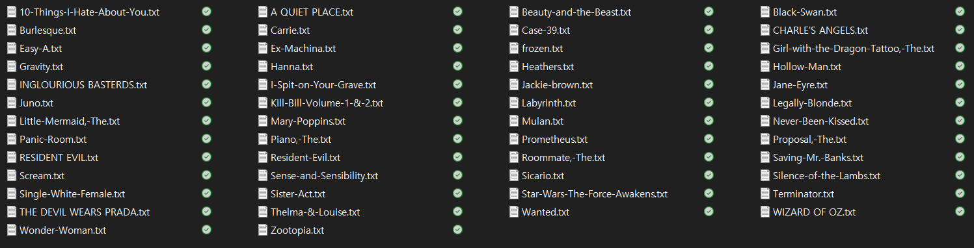
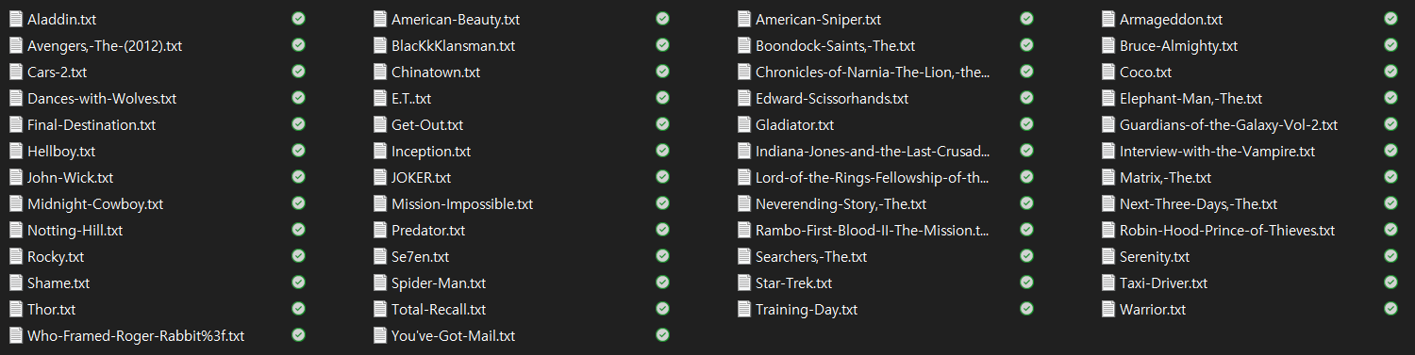
Female Male
Notes:
These is the whole movie scripts I used on this project. The database is collected regardless of genres, so you can see there’re both romantic/Sci-Fi/Animation blahblahblah in both folders. Also, I only include one movie if that’s a series like Harry potter to avoid redundant results.

Slide 7
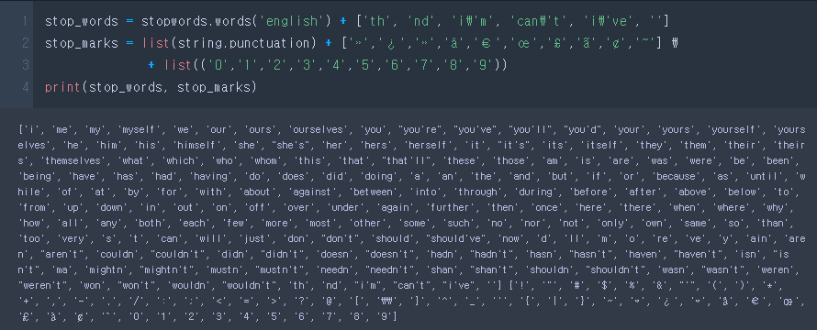
Remove stop words
Referring nltk.corpus>stopwords.
Add more exceptions which could be found while development including numbers and punctuation marks.
Couldn’t exclude verb tenses.
ex) if treating present tense suffix ‘–ing’ as a stop word, the words like beginning will be eliminated.
Development – Code Details (1_TermIndexing.ipynb)
Notes:
To remove the stopwords, I referred to nltk.corpus library’s english stopwords list. But somehow, it did not perfectly filtered out the stopwords, so I added some more while analyzing, such as ‘th-’ which is used when counting numbers, and ‘i’m’ or ‘can't’ like abbreviation . I also add a punctuation marks like question mark, numbers and etc. On the other hand, there’s a limit that these stop words cannot exclude the verb tenses. Ex)
Even though I could make it all as a list by typing each of them, but I used this library and print out to look what's in there. so.. hope it shouldn't be a problem. because still I add some stop words by myself.. ㅎㅎ

Slide 8
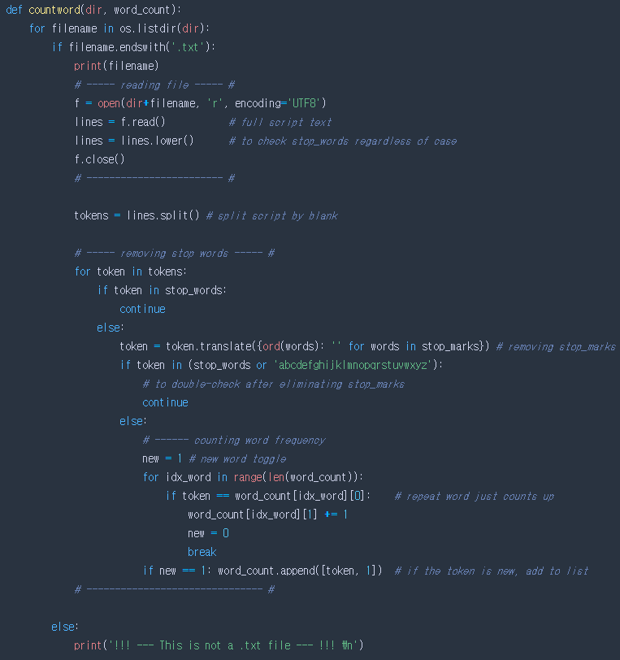
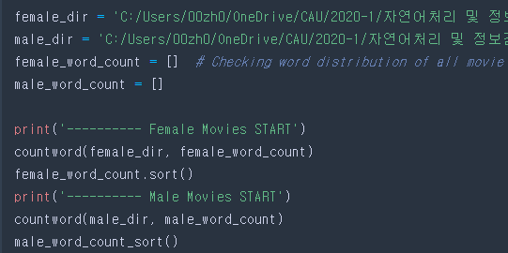
Count Words Function
Open .txt file from each directory.
Split whole script lines by blank. One word is called ‘token’.
If token is or contains a stop word, function ignores it. If not, it checks whether the token is already in the list(which is a table for word frequency) or not. And then it counts up.
Repeat this process while reading is over, and then pass to next text file.
Development – Code Details (1_TermIndexing.ipynb)
Notes:
This is the countword function. The process is, first, It opens the text file in the input directory folder and then split whole script lines by blank. Then removing the stopwords, and counts up. The function repeats this process while reading text file is over, then pass to next file.
And after conducting the countword function, I sort each list alphabetically.

Slide 9
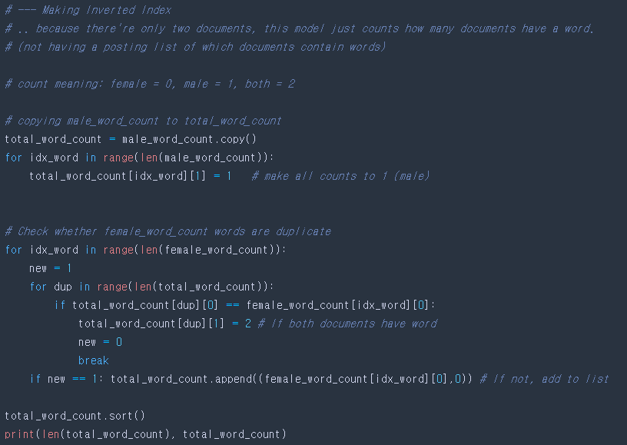
Make Inverted Index
To know which words are used on both female/male movies, make a list of total vocabulary.
Because there’s only two documents(female/male) in this project, it just counts how many documents have that word. (Not having a posting list of which documents contain the words.)
Development – Code Details (1_TermIndexing.ipynb)
Notes:
…

Slide 10
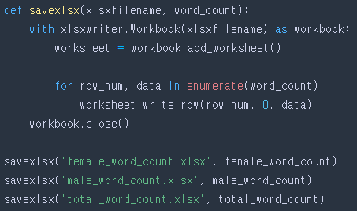
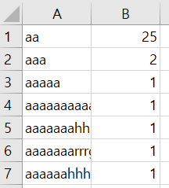

Save results as .xlsx file
Make word count results as excel file each.
Development – Code Details (1_TermIndexing.ipynb)
Notes:
For the results, i make an excel file, rather than plotting graphs via python to make the graph clear.

Slide 11
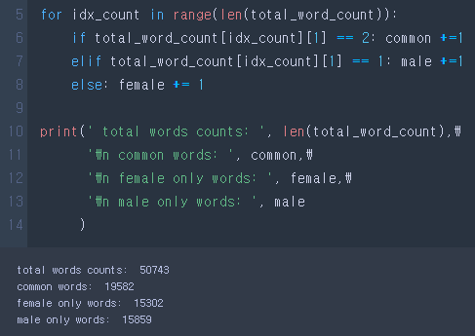
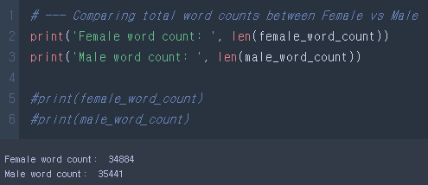
MALE
word count
35441
FEMALE
word count
34884
MALE
vocabularies
15859
FEMALE
vocabularies
15302
Word frequency
Number of vocabularies
Conclusion – Results
Notes:
In conclusion, As you can see, Male word counts and vocabularies are greater than female’s. Although the gap is small, my assumption that female starring movies would have more vast vocabularies and would use words more frequently, is wrong.

Slide 12
Conclusion – Results
Notes:
I also compared top 50 words between female and male movies.
The original hypothesis I made was that female movies would have much more feminine words. As results said, in male’s movie, the human name appears more than females’ do. But, the type of words relevance to gender is not clear.
In addition, As the words like int, back or continued are used in movie to infer camera frame, we can analyze that female movies have much more intro scenes while males’ have back scene more.

Slide 13
Thank you !

